Slide 1
InvestEU, NetZero and the growing debts of EU citizens
Presentation by Bob Lyddon for the IES-Europe/IREF Summer University in Aix-en-Provence
22 July 2023

Slide 2
Bob Lyddon - who I am
Independent international banking consultant since 2000
Consultant on the implementation of the Euro for PricewaterhouseCoopers 1997-1999
Payments and cash management banker 1991-1997
Corporate and capital markets banker 1980-1991
Co-author in 2020 of ‘Managing Euro Risk’, an examination of the weak legal structure of the euro and its not having any ‘central bank money’
Author in 2023 of ‘The shadow liabilities of EU Member States and the threat they pose to global financial stability’

Slide 3
Agenda
What is a ‘shadow liability’ and what volume of them exists
How ‘shadow liabilities’ have been used to attempt to reflate the EU and Eurozone economies
InvestEU as a prime mechanism for this reflation
How InvestEU creates debts that ultimately fall on the public
How the public bears all the risks one way and another
How Net Zero is being used as the imperative to legitimize the debt build-up and under the InvestEU banner

Slide 4
What is a ‘shadow liability’?
A debt or a risk as a guarantor not included by Eurostat in its definition of ‘General government gross debt’ or ‘GGGD’
GGGD is the anchor figure for calculation of a country’s Debt-to-GDP ratio
The ‘shadow liability’ remains the responsibility of the public
Debtor category | Definition
EU supranationals | Debts and risks created by entities like the EU itself, the European Investment Bank and the European Central Bank
‘General government gross debt’ | The direct debts of a member state government, its state agencies, and regional and municipal authorities
Public sector entities falling outside ‘General government’ | Debts of transport, electricity, water and gas utilities; liabilities created in financing schemes like InvestEU and the European Guarantee Fund; debts of national central banks

Slide 5
Shadow debts – borrowings the public is liable for
Category | Amount in EUR billions
The European Union legal entity | 174.8
Other public sector entities | 1,993.4
Structures like InvestEU | 1,246.1
Net debts in TARGET2 payment system | 1,457.2
Gross debts in TARGET2 payment system | 1,500.1
Total at end of 2021 | 6,371.6
Percentage of 2021 EU GDP | 44%
EU’s 2021 ratio of Debt-to-GDP based on GGGD | 90%
Revised ratio with shadow debts added | 134%

Slide 6
Shadow contingent liabilities – risks and guarantees that the public could be called upon to pay up for
Category | Amount in EUR billions
The European Union legal entity | 792.7
The European Financial Stability Facility | 190.9
The European Stability Mechanism | 332.0
The European Investment Bank | 226.5
The European Guarantee Fund | 23.2
‘Market losses’ on European Central Bank programmes | 826.0
‘Credit losses’ on European Central Bank programmes | 1,419.8
Total | 3,811.1
Percentage of 2021 EU GDP | 26%
EU’s 2021 Debt-to-GDP with shadow debts added | 134%
Revised ratio with shadow contingent liabilities added | 160%

Slide 7
Theoretical basis of public interventions
Keynesian economics:
  Public sector involvement to stimulate and accelerate the economic cycle
  Creates new infrastructure assets that enable and encourage private sector growth in the medium term
Risks:
  Displacement of the private sector
  Private sector efforts are channeled only into areas enjoying political favour within a so-called ‘public-private partnership’
  The private sector enjoys such high returns on public sector risk (i.e. very low risk) that it avoids entrepreneurial risk-taking
  The new infrastructural assets are actually replacement capacity
  There is no pull-through of economic growth in the medium term and the deferred cost of the schemes is deflationary

Slide 8
EU’s trajectory of debts and GDP
Development of indicators | Total | Per capita
Estimated annual increase in ‘shadow liabilities’ since 2011 | €400 billion | €895
Annual increase in ‘General government gross debt’ since 2011 | €459 billion | €1,027
Total annual increase in public debt and liabilities | €859 billion | €1,922
Annual EU GDP increase since 2011 (UK excluded) | €478 billion | €1,070
GDP growth net of the debt/liabilities incurred to enable it | (€381 billion) | (€852)
EU population has been steady at around 447 million, with UK stripped out
It looks as if the Keynesian experiment has failed to stimulate GDP growth
Nevertheless it has stimulated a growth in liabilities which threatens to be deflationary in the medium term

Slide 9
InvestEU (or the Juncker Plan or the European Fund for Strategic Investments or EFSI)
Agreed upon in 2012 by Angela Merkel and Francois Hollande directly after the Eurozone sovereign debt crisis;
They agreed to ‘fully mobilize the potential of the EIB for engaging in counter-cyclical public spending, also known as Keynesian economics’;
Reuters at the time reported that ‘German Chancellor Angela Merkel added her voice on Saturday to calls to bolster the European Investment Bank (EIB) and to use EU infrastructure funds more flexibly to help spur economic growth in Europe. Her comments are part of a new German emphasis on growth-boosting measures to complement painful tax hikes and spending cuts that have triggered a political and popular backlash against austerity across the Eurozone.’

Slide 10
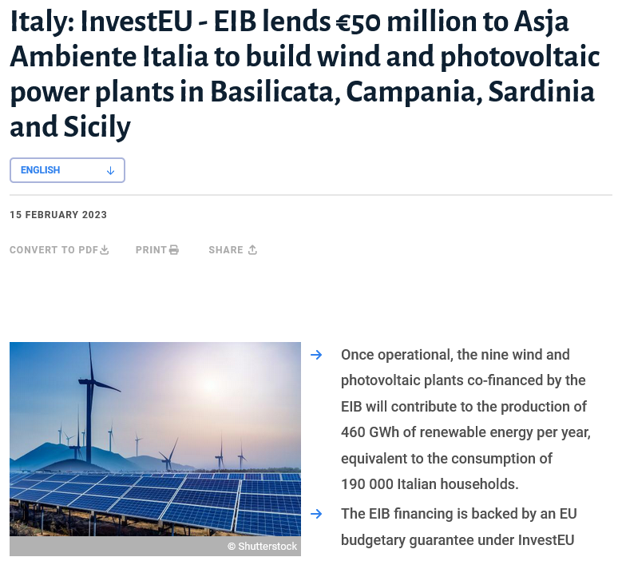
Typical InvestEU ‘Green Energy’ project
Construction of new power plants using wind and photovoltaic technology
The offtake will be ‘the equivalent to the consumption of 190,000 Italian households’
Which is not to say…
  It will power those households
  The households are new ones
There is no mention of who will buy and who will use the offtake

Slide 11
InvestEU financing template
Senior debt | 65-75% of the project cost The lender stands at the front of the Creditor Queue They may even have tangible security (a mortgage on the project’s fixed assets, a lien on the project’s accounts receivable and inventory) The credit risk they take reduces with the increasing thickness of the layers of money supplied by the other lenders, who stand behind them in the Creditor Queue
Mezzanine debt | 15-20% of the project cost Provided in whole or in part by the European Investment Bank on its normal terms apart from taking a place in the Creditor Queue behind Senior Debt
Subordinated debt | 5-10% of the project cost Enabled by a guarantee or an equity commitment issued by the European Investment Fund to the benefit of the suppliers of these funds
Equity | No more than 5% of the project cost

Slide 12
Distribution of risks and returns
Equity:
  Should take the most risk and get the highest return in exchange for standing at the back of the Creditor Queue
  A project sponsor, injecting 5% or less of the cost, has multiple ways of earning that back indirectly – management fees, supplying the project, royalties for lending intellectual property… - rather than as dividends on profits or capital growth
Subordinated debt:
  Given the preferred position of the supplier of equity, it is the supplier of the Subordinated Debt who carries the highest risk…
  …but they enjoy either a guarantee in their favour from the European Investment Fund which they can call upon and get reimbursed…
  …or the European Investment Fund has committed to buy new equity in the project if things get rough, which will insert a new actor behind them in the Creditor Queue

Slide 13
How much risk has the European Investment Fund taken on?
The guarantees and equity commitments issued by the EIF are contingent liabilities, so they are not recorded on the EIF’s balance sheet
That is legitimate, but the EIF does not give a listing of the amounts of the guarantees and equity commitments it has issued
It provides information on each transaction – in fact all the information except what is needed to assess the risk the EIF has taken:
  No disclosure of the issuer of the counterindemnity behind a guarantee i.e. who has to pay the EIF if the EIF’s guarantee is called by its beneficiary
  Under what circumstances the EIF might be called upon to pay in cash on the back of an equity commitment and what equity instrument the EIF would end up owning
  What that equity instrument would be worth, and how and when the EIF could sell it and get their money back

Slide 14
Size of the InvestEU programme and its sister, the European Guarantee Fund
In the absence of specific disclosure by the EIF, one has to calculate the amount of money raised – meaning the amount ‘mobilized’
This is the same as the amount of debt raised, because the equity amount is tiny
It is also the amount of the public’s liability because, one way or another, the public will pay it back – even if it is a multiple of the EIF’s and the EIB’s involvement
Programme | Period | Amount ‘mobilized’
InvestEU | During the 2014/20 EU Multiannual Financial Framework, under EU first-loss guarantee of €16 billion | €612 billion
European Guarantee Fund | 2022 – InvestEU projects subject to separate guarantees direct from member states | €60 billion
InvestEU projection | During the 2021/27 EU Multiannual Financial Framework, under EU first-loss guarantee of €26.2 billion | €1,000 billion

Slide 15
Locked-in sale of project offtake
The offtake is subject to an irrevocable contract with a fixed minimum price with either:
  A public utility
  A private utility with a locked-in public customer base
The receipts from the sale of the offtake pay for the loan interest and repayments
The loans can be classified as ‘public sector risk’
The Senior and the Subordinated lenders can also point to the Credit Enhancement supplied to their loans by the EIB’s loan and the EIF’s guarantee or equity commitment – both being public entities
It is public sector risk as far as the lenders are concerned – but how about the borrower view?
Distributor sells to general public
Offtake sold to distributor
Financing supported by public entities

Slide 16
Here is the accounting of the public’s risk
Party | On-balance sheet | Off-balance sheet | Comments
Project sponsor company | €0 billion | €0 billion | It is a privately-owned company
EIB/to end of 2021 | €117 billion | €0 billion | InvestEU
EIB/during 2022 | €16 billion | €0 billion | European Guarantee Fund
EIB/2023-27 | €100 billion | €0 billion | InvestEU again
EIF | €0 billion | €0 billion | Ought to show its contingent liabilities
EU/2014-20 | €0 billion | €16 billion | First-loss guarantee
Member states | €0 billion | €23 billion | European Guarantee Fund
EU/2021-27 | €0 billion | €26 billion | First-loss guarantee
Total at end of 2022 | €133 billion | €65 billion | All guarantees are already on-risk
Total by end of 2027 | €233 billion | €65 billion

Slide 17
The public’s actual risk is much higher
The public is at risk for the entire amount ‘mobilized’: €1.7 trillion by the end of 2027
That funding is all taken on by a private sector company (however thinly capitalized) so only part of it appears in public accounts - the EIB’s €233 billion of loans
Eurostat is extremely weak in recording the contingent liabilities of member states i.e. the EU and European Guarantee Fund guarantees towards ‘EIB Group’ (meaning EIB and EIF) are not recorded
The remaining €1.7 trillion are supported on the EIF’s guarantees/equity commitments towards the highest-risk slices…
…and the EIF’s guarantees/equity commitments are supported by the public via EU/member state guarantees towards ‘EIB Group’

Slide 18
Impact of higher interest rates
Either the price of the offtake can be increased so the public pays more for it
Or, if the offtake price is fixed, there is a higher risk for lenders
The risk escalates most for the providers of the highest-risk slices…
…which are the ones that are supported by public institutions…
…who can pass their losses back to the public
Heads, I win, tails, you lose

Slide 19

Legitimization and source of disquiet
The EIB has nominated itself as the EU’s Climate Bank
Net Zero is an imperative, isn’t it?
At least it is now, even if it wasn’t in 2014 when InvestEU was set up
Is InvestEU being dressed up in Climate Change colours in order to legitimize a course of action that has already been decided upon?
Is that a form of ‘greenwashing’?
At least it is a good excuse for doing more of what you wanted to do anyway, like partying for a charity

Slide 20
Summary
InvestEU is legitimized under the heading of Net Zero but is a classic example of Keynesian economics
The problems arise when:
  So much of the total of economic activity is being directed by the state that it channels, displaces or even strangles entrepreneurial activity
  The public is put on-risk over and over again, though different schemes and mechanisms
  No official body captures the total of liabilities weighing upon the single amount of capacity to service debt
  There is no pull-through of economic growth and the only result is a heavy burden of debt service that becomes deflationary

Slide 21
Conclusion of InvestEU, NetZero and the growing debts of EU citizens
Presentation by Bob Lyddon for the IES-Europe/IREF Summer University in Aix-en-Provence
Contact details:
Email is bob@lyddonconsulting.com
Twitter is @LyddonConsult
Phone is +44 7939 132341

